Slide 1


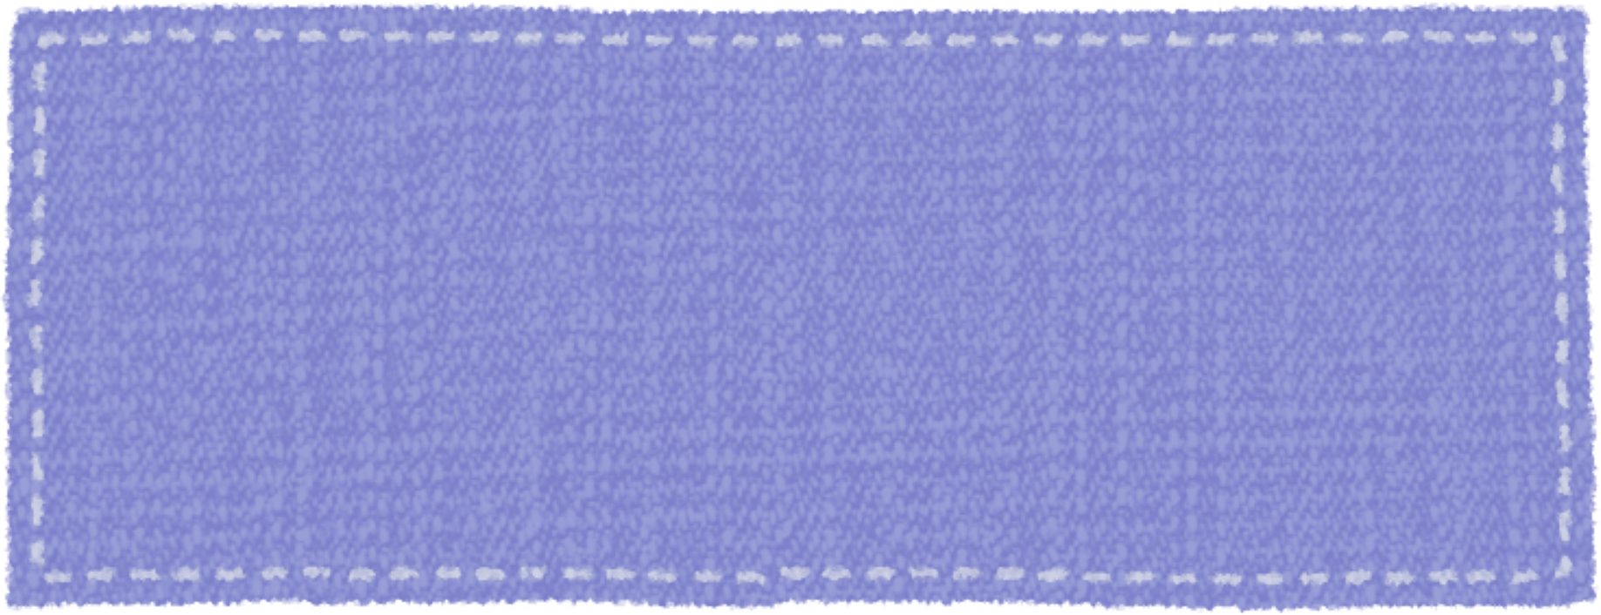
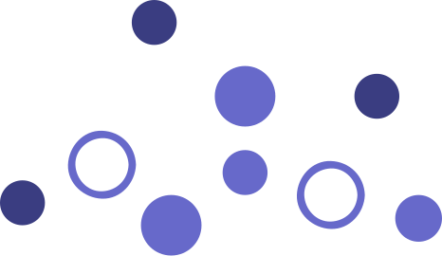
SLEEP STAGES CLASSIFICATION
USING DEEP LEARNING
supervised by :
DR. Ibrahim Sadek
ENG. Veronica William

Slide 2
OUR TEAM
WAFAA HASSAN RAMADAN
SOHAILA ELSAYED IBRAHIM
MENNAT ALLAH MOHAMED ELSAYED

Slide 3

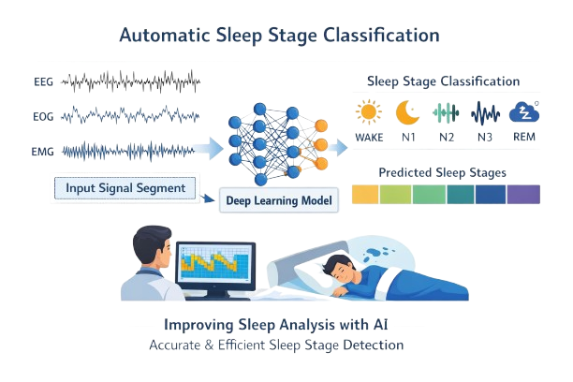
INTRODUCTION
Develop a deep learning–based model for automatic sleep stage classification from physiological signals.
The model analyzes time-series signal data and classifies each segment into one of the five sleep stages:
Wake, N1, N2, N3, and REM.
The proposed system aims to improve the efficiency and accuracy of sleep analysis.
It can assist clinicians by reducing manual scoring effort and increasing the reliability of sleep stage detection.
01

Slide 4
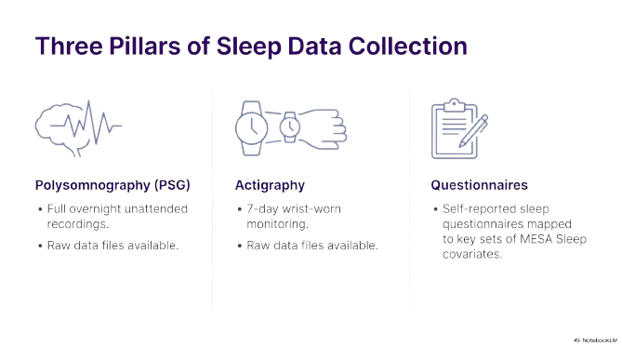
DATASET
The MESA (Multi-Ethnic Study of Atherosclerosis) Sleep Dataset is a large-scale, comprehensive collection of physiological sleep data.
It is hosted by the National Sleep Research Resource (NSRR) and was originally designed to study the links between sleep characteristics and cardiovascular health across a diverse demographic of over 2,000 participants.
02

Slide 5
DATASET
Dataset Structure:
Signal Data (X):
The input data consists of time-series physiological signals. These signals provide valuable information about brain activity and physiological changes occurring during different sleep stages.
Each signal sample is represented as a sequence of numerical values describing signal amplitude over time. These signals include measurements of: [EKG, EOG-L, EOG-R, EMG, EEG1, EEG2, EEG3, Pres, Flow, Snore, Thor, Abdo, Leg, Therm, Pos, EKG_Off, EOG-L_Off, EOG-R_Off, EMG_Off, EEG1_Off, EEG2_Off, EEG3_Off, Pleth, OxStatus, SpO2, HR, DHR]
03

Slide 6
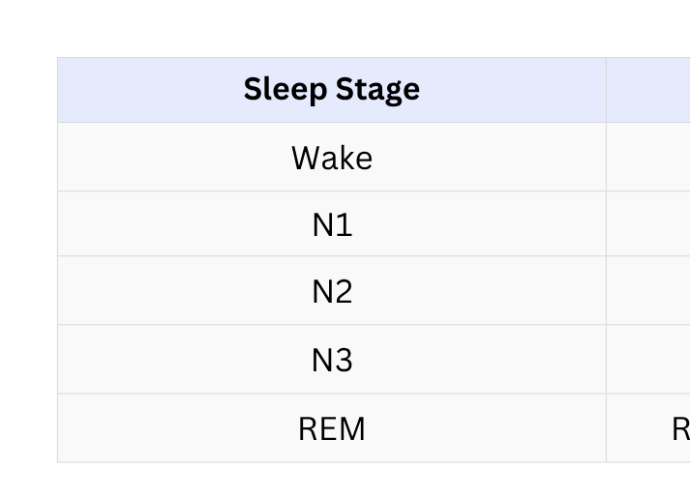
DATASET
annotation (labels) (y)
The XML file acts as a "Time-Stamped Log" or "Metadata Map" created by sleep technicians to describe the continuous signals found in the EDF file.
Sleep Staging :Divides the entire recording into 30-second epochs.
Scored Events (Clinical Observations):Respiratory Events - Oxygen Desaturation - Limb Movements
04

Slide 7
ELECTROOCULOGRAPHY (EOG) SIGNAL
EOG: Non-invasive electrophysiological technique that records corneo-retinal standing potential
Captures horizontal and vertical eye movements through potential differences between electrodes
Key Advantages:
Less invasive than EEG (fewer electrodes)
Strong correlation with REM sleep (eye movements)
More suitable for wearable devices
Lower cost and easier setup
05

Slide 8
PROJECT OBJECTIVES
Develop a robust deep learning framework for multi-class sleep stage classification (Wake, N1, N2, N3, REM) using single-channel EOG
Transition from conventional multi-channel EEG toward scalable, wearable, and minimally intrusive solutions
Address inherent class imbalance in sleep stage distribution through advanced sampling and weighting strategies
Achieve competitive performance (~80% test accuracy) with a computationally lightweight architecture suitable for edge devices
06

Slide 9
Data reading & labeling
06
Evaluation
01
Signal Preprocessing
pipeline
05
Training
02
03
Preparation
04
Model
Architecture
07

Slide 10
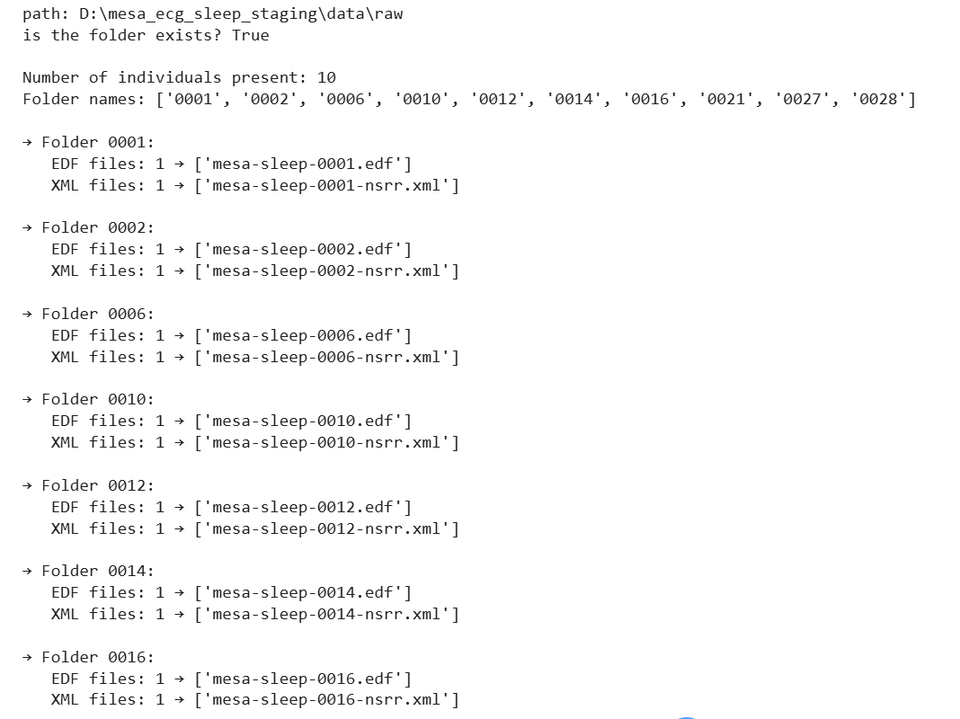
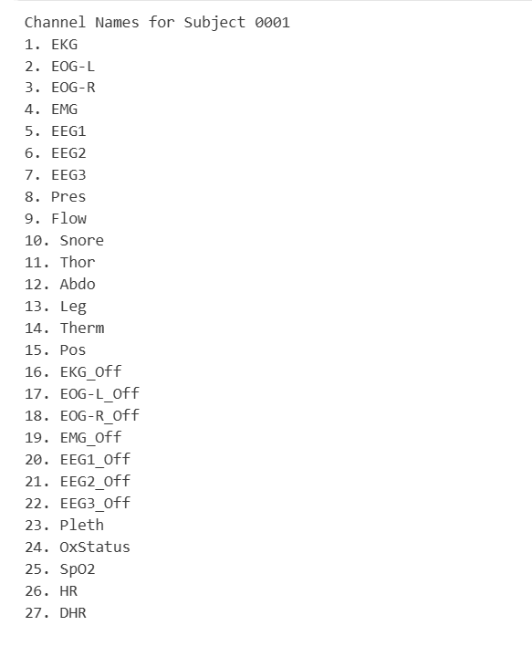
DATA READING
08

Slide 11
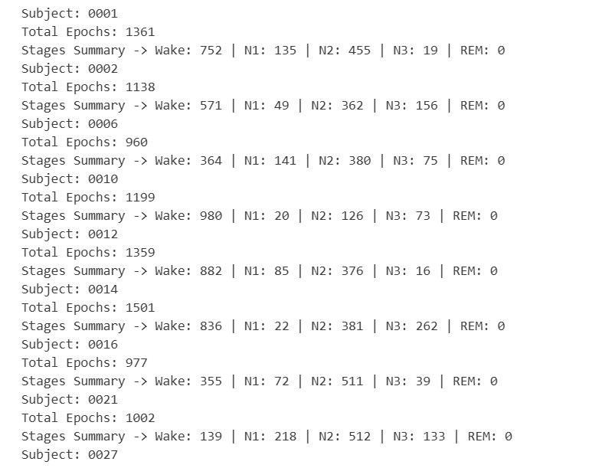
LABELING
09

Slide 12


SIGNAL PREPROCESSING
FILTERING:
CHANNEL SELECTION:
Band-pass filter (0.3 – 30 Hz) applied to EOG signals.
Left EOG channel
EPOCHING:
NORMALIZATION:
into 30 seconds to match and align the annotations, given a sampling rate of 256 Hz, each epoch contains 30*256 data points
Z-score normalization
Ensures stable training across different participants
10

Slide 13
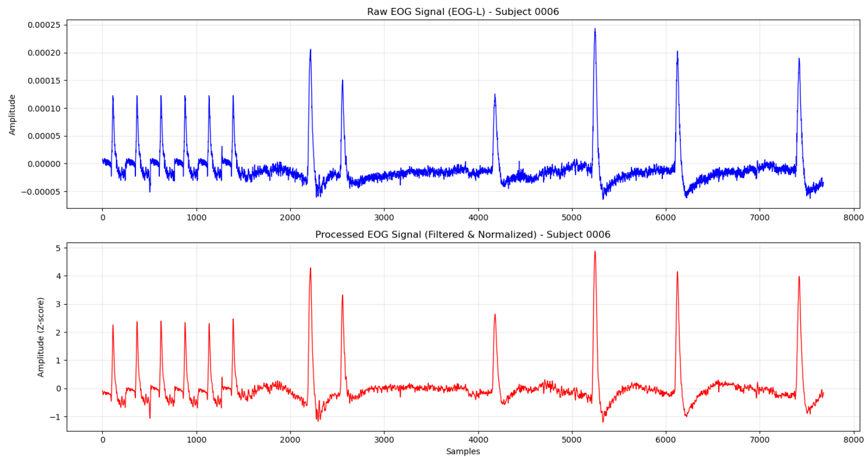
RAW VS PROCESSED.
11

Slide 14
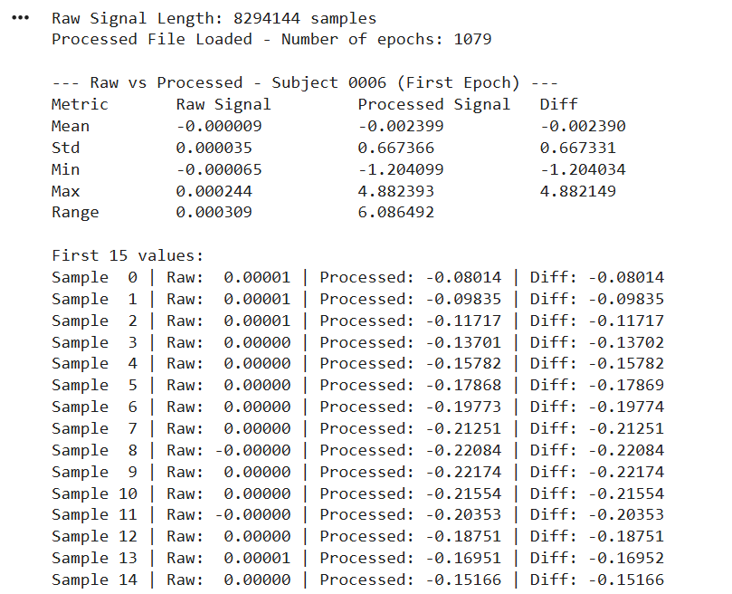
RAW VS PROCESSED.
12

Slide 15
DATA PREPARATION & SPLITTING
Signals are divided into 30-second epochs (7680 samples at 256 Hz)
Each epoch is matched with its sleep stage label from the XML file
Invalid epochs or those containing artifacts are discarded
DATA ALIGNMENT:
LABEL ENCODING:
Sleep stage labels are converted to numerical values: 0 = Wake, 1 = N1, 2 = N2, 3 = N3, 4 = REM
HANDLING IMBALANCE:
Sleep stages are highly imbalanced (especially N1 and N3)
Techniques Applied: SMOTE + Class Weights
This improves model performance on minority classes
DATA SPLIT:
The dataset is divided into:
70% Training
15% Validation
15% Test
13

Slide 16
MODEL ARCHITECTURE
-Hybrid Model (CNN + LSTM + Attention)
-Input Single EOG Signal (30 seconds)
-Model Structure:
Residual CNN Extracts important features from the signal
Bidirectional LSTM Understands the sequence and timing of sleep patterns
Attention Mechanism Focuses on the most relevant parts of the signal
Classification Layer Predicts one of 5 sleep stages:
Wake | N1 | N2 | N3 | REM
Goal: High accuracy with a lightweight model suitable for wearable devices
14

Slide 17
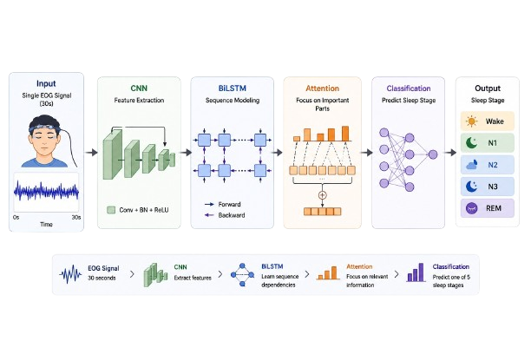
MODEL ARCHITECTURE
15

Slide 18
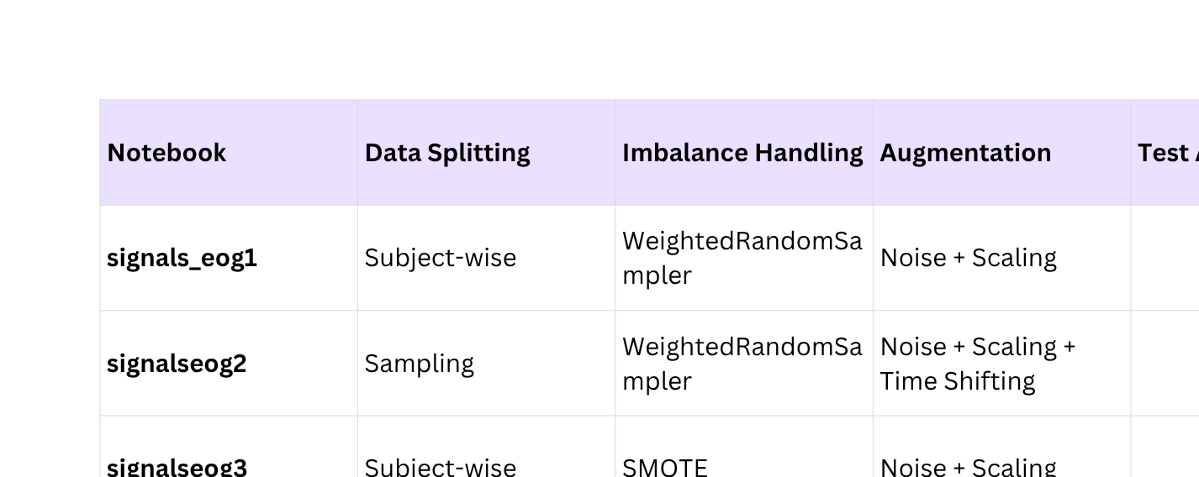
MODEL EVOLUTION ACROSS NOTEBOOKS
We developed 4 versions of the project to improve performance step by step:
16

Slide 19
TRAINING PROCESS & RESULTS
-Training Parameters:
Epochs: 50
Batch Size: 32
-Key Observations During Training:
Training Accuracy reached 99.5% by the final epoch
Best Validation Accuracy: ~83.2%
Model shows good convergence with stable training
17

Slide 20
TRAINING RESULTS
1ST VERSION “SIGNALS_EOG1”
2ND VERSION “SIGNALS_EOG2”
3RD VERSION “SIGNALS_EOG3”
4TH VERSION “SIGNALS_EOG4”
18

Slide 21
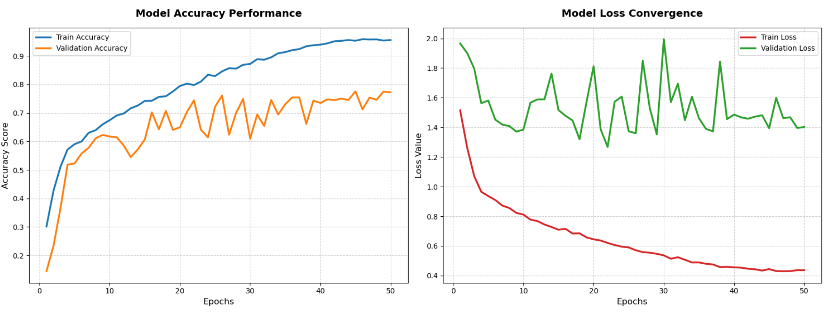
TRAINING & VALIDATION CURVES
1ST VERSION “SIGNALS_EOG1”
19

Slide 22
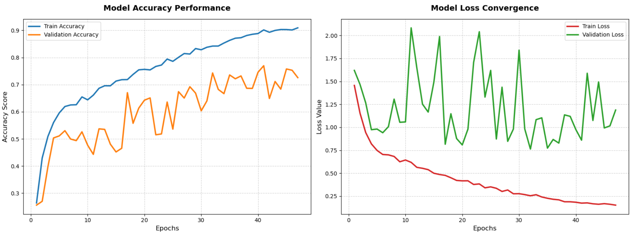
TRAINING & VALIDATION CURVES
2ND VERSION “SIGNALS_EOG2”
20

Slide 23
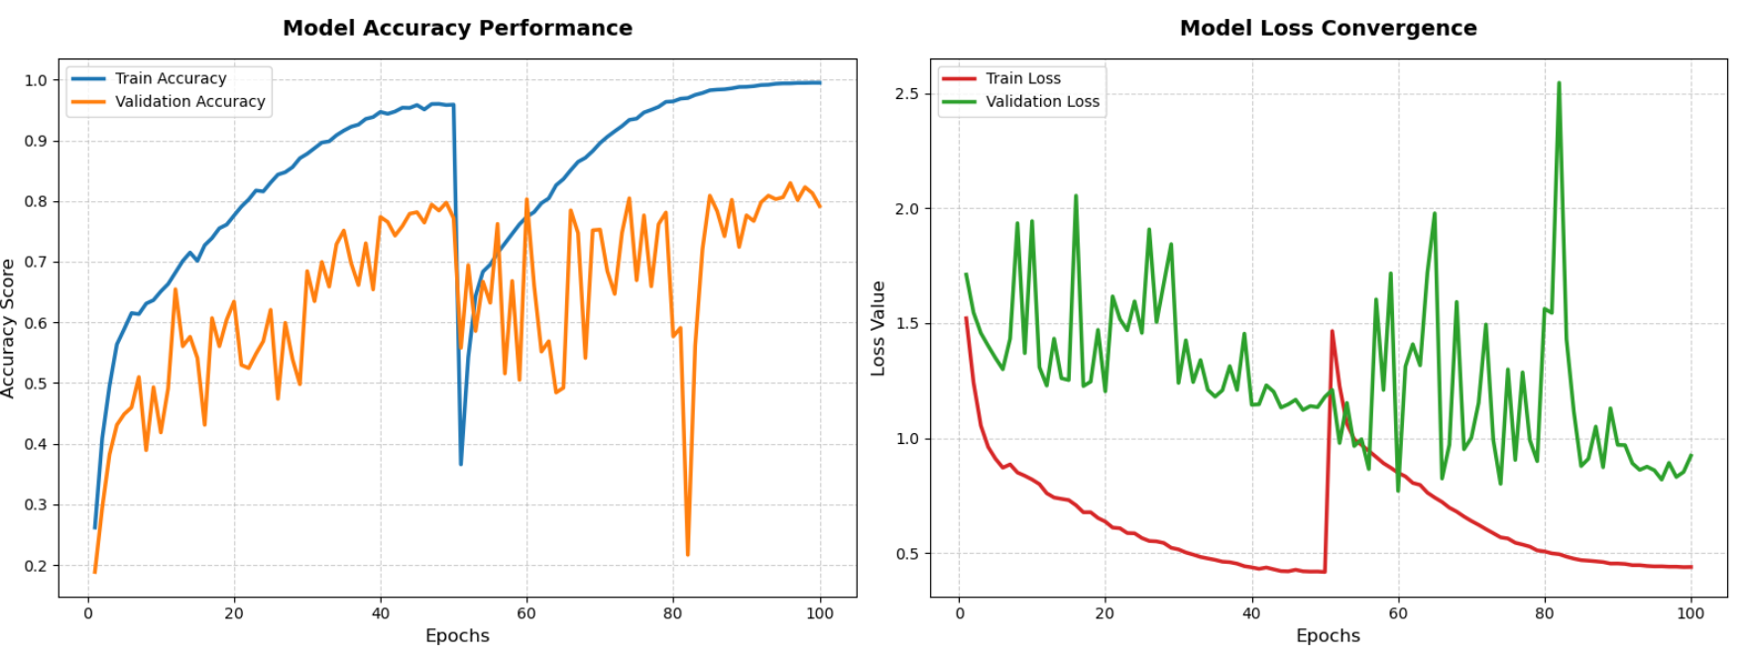
TRAINING & VALIDATION CURVES
3RD VERSION “SIGNALS_EOG3”
21

Slide 24
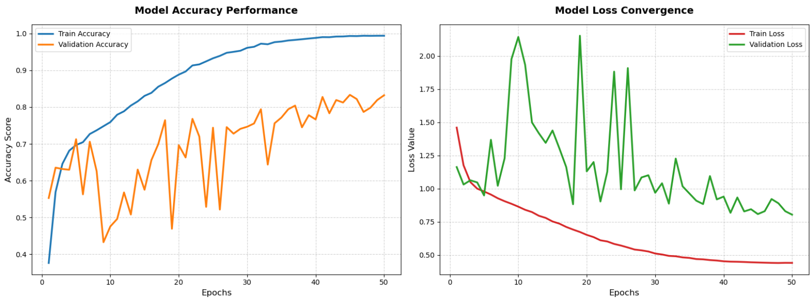
TRAINING & VALIDATION CURVES
4TH VERSION “SIGNALS_EOG4”
22

Slide 25

EVALUATION & RESULTS
1ST VERSION “SIGNALS_EOG1”
2ND VERSION “SIGNALS_EOG2”
3RD VERSION “SIGNALS_EOG3”
4TH VERSION “SIGNALS_EOG4”
23

Slide 26
CONFUSION MATRICES
24

Slide 27
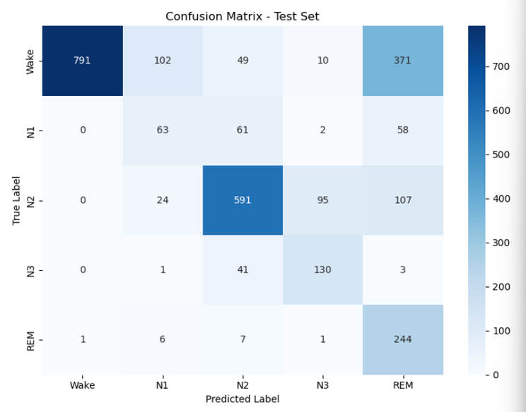
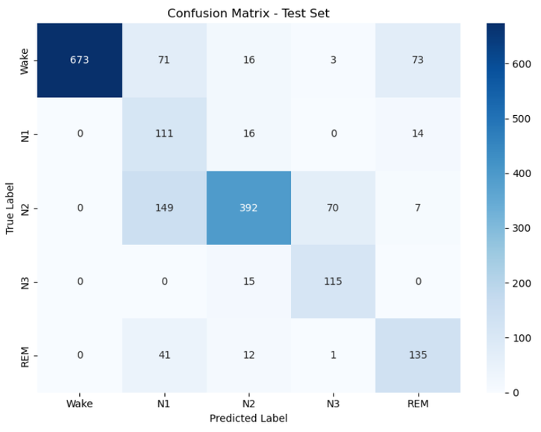
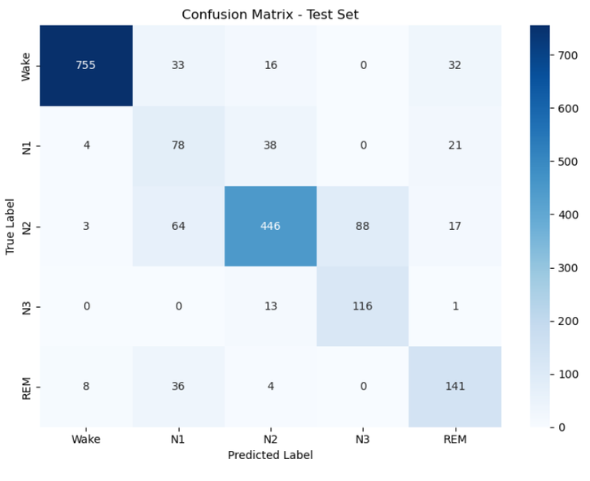
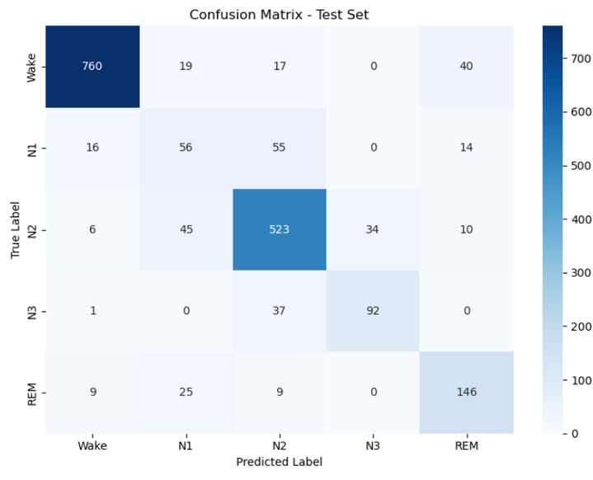
1ST VERSION
2ND VERSION
3RD VERSION
4TH VERSION
25

Slide 28
CLASSFICATION REPORTS
26

Slide 29
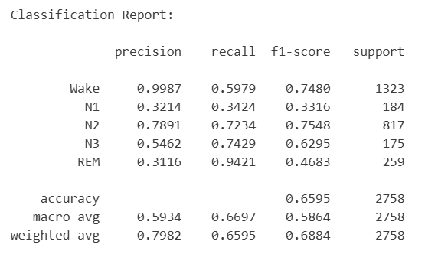
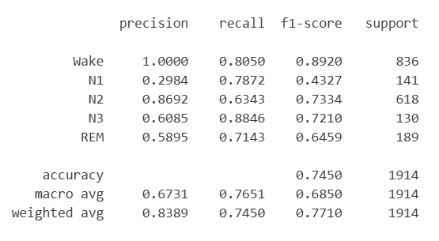
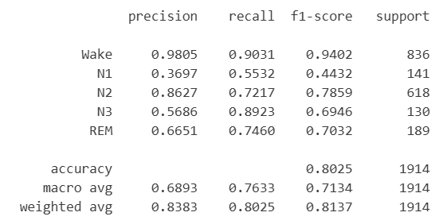
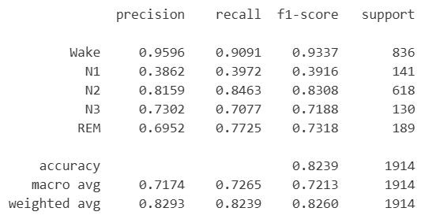
1ST VERSION
2ND VERSION
3RD VERSION
4TH VERSION
27

Slide 30
ROC CURVES
28

Slide 31
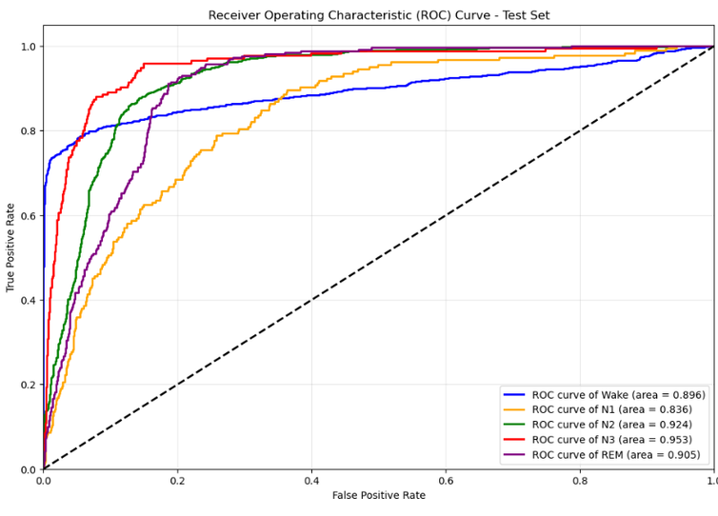
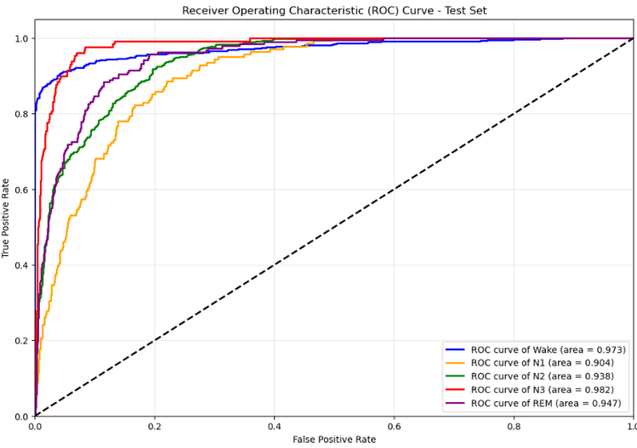
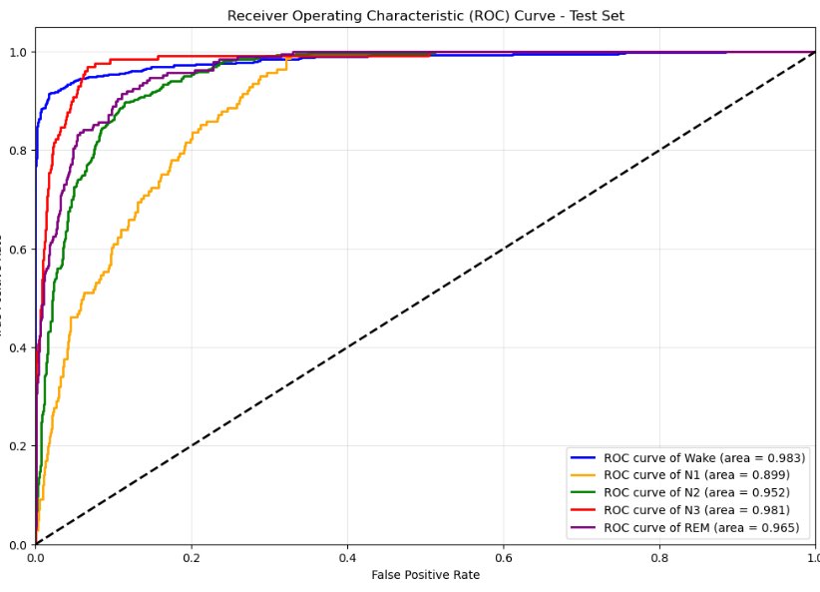
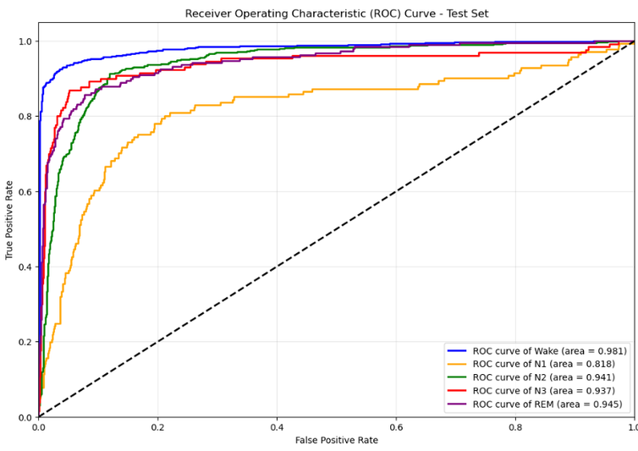
1ST VERSION
2ND VERSION
3RD VERSION
4TH VERSION
29

Slide 32



RELATED PAPER
Paper:
U-Sleep: Resilient High-Frequency Sleep Staging
Objective:
Develop a robust deep learning model for automatic sleep stage classification that works with limited channels (EEG + EOG) across different datasets and clinical settings.
Methodology:
Uses single EEG + single EOG channels
Fully Convolutional Neural Network (U-Net inspired architecture)
Trained on large-scale PSG data including MESA dataset
Works with different sampling rates and electrode placements
Classify sleep into five stages: Wake, N1, N2, N3, REM
Results:
High performance on MESA and multiple other datasets
Mean F1 score around 0.79 across stages (comparable to human experts)
Strong results with limited channels (EEG + EOG)
Very resilient and generalizable to new clinical data
30

Slide 33
THANK
YOU

